Slide 1

Assalamu-Alaikum
بِسْمِ اللَّهِ الرَّحْمَنِ الرَّحِيم

Slide 2
Welcome to our Software Project Presentation

Slide 3
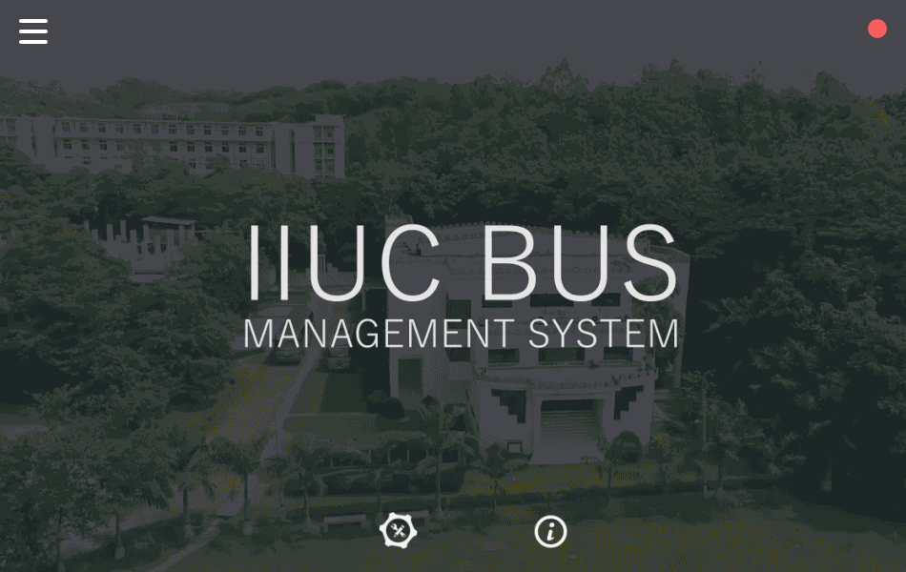
Starting Interface

Slide 4
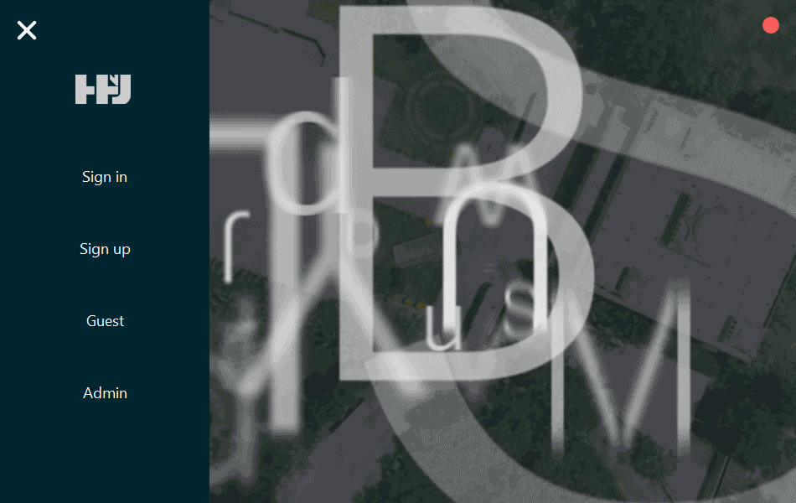
Main Menu

Slide 5
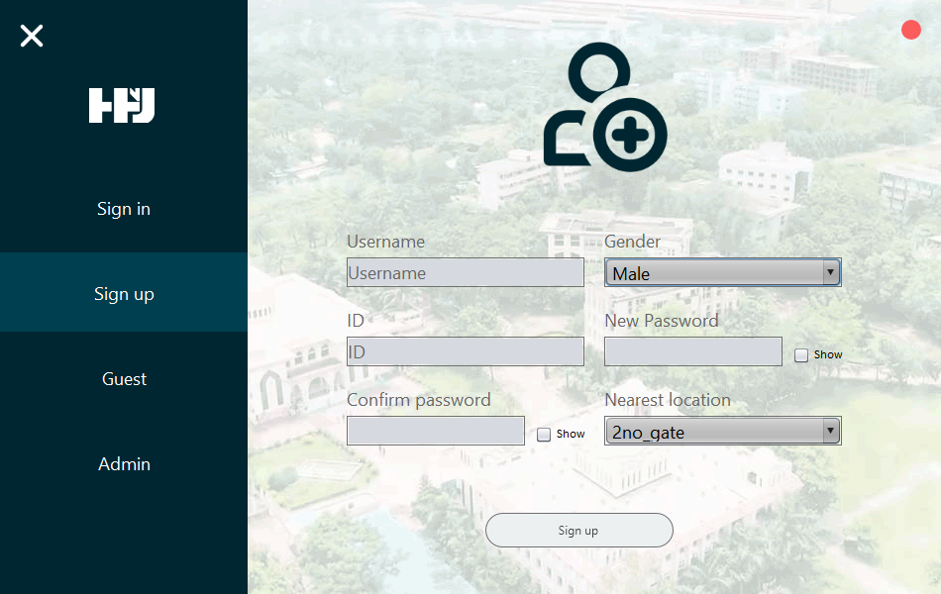
Sign-up Interface

Slide 6
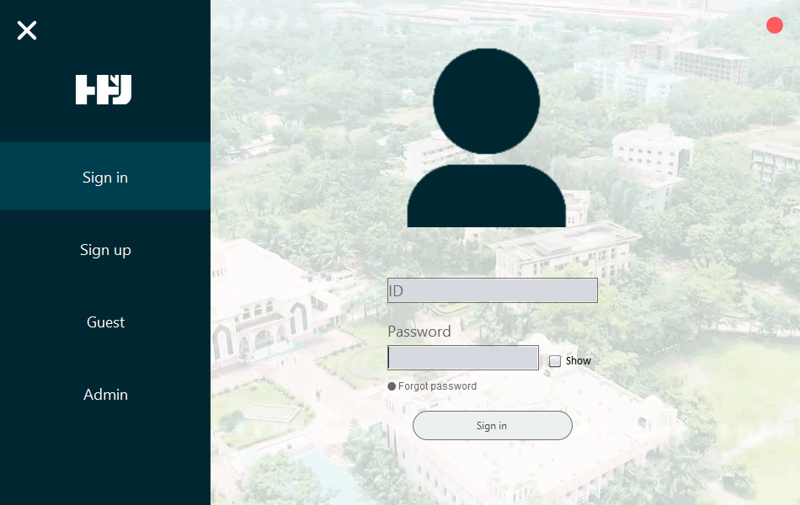
Sign-in Interface

Slide 7
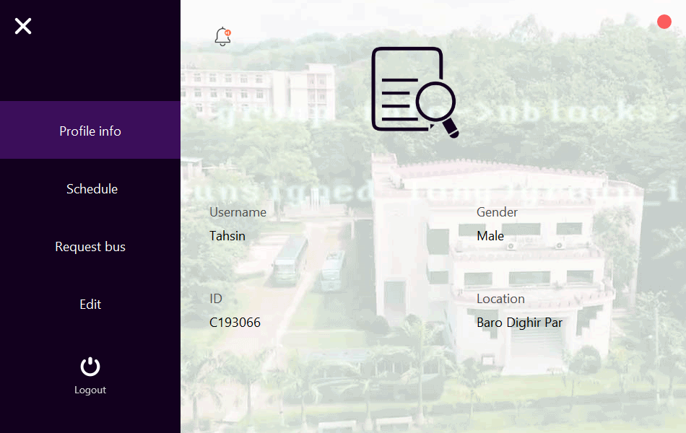
User Profile

Slide 8
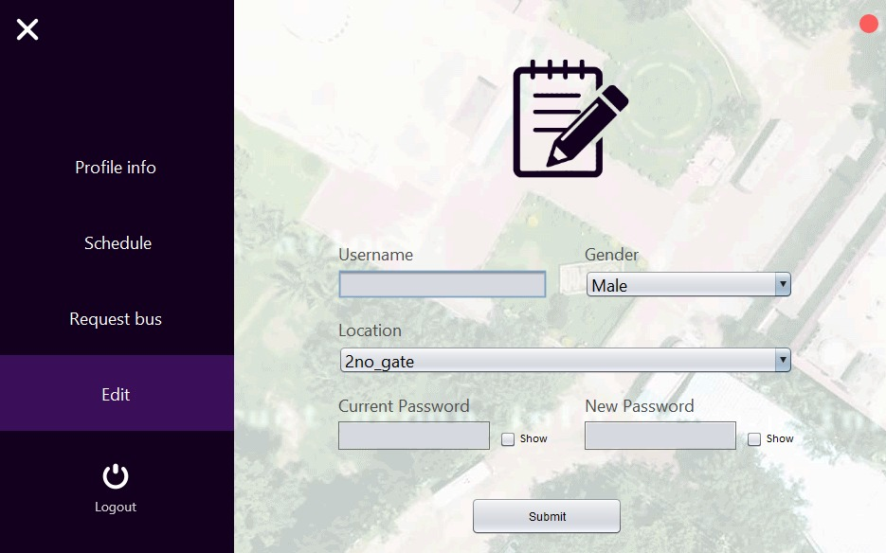
Edit Profile

Slide 9
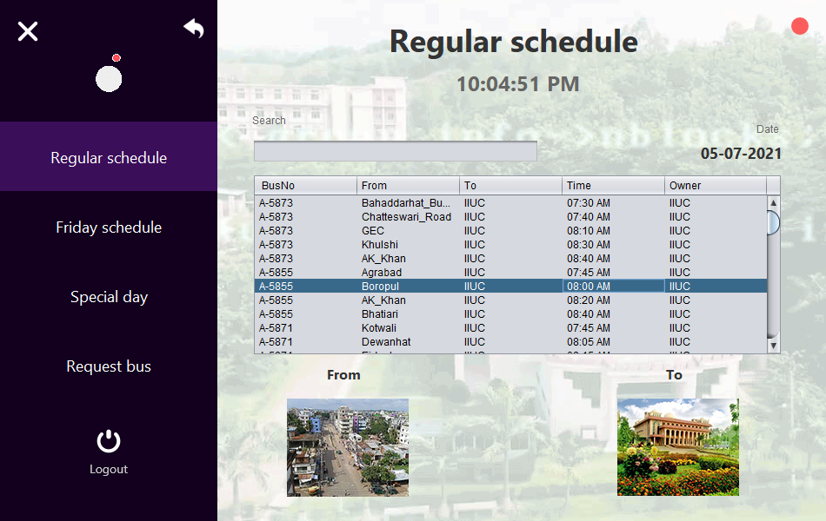
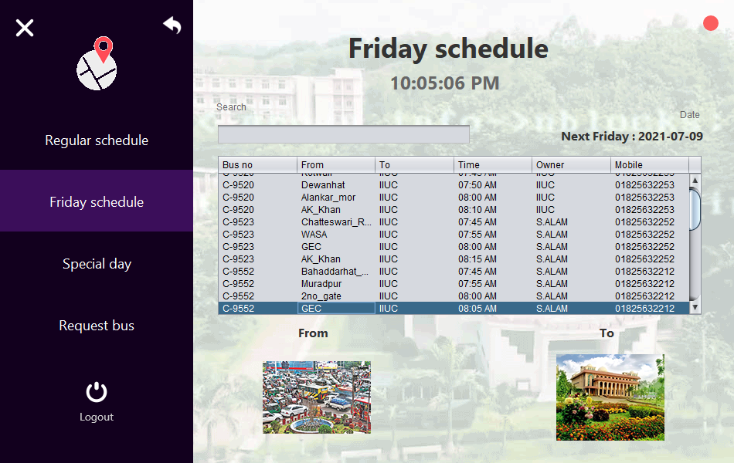
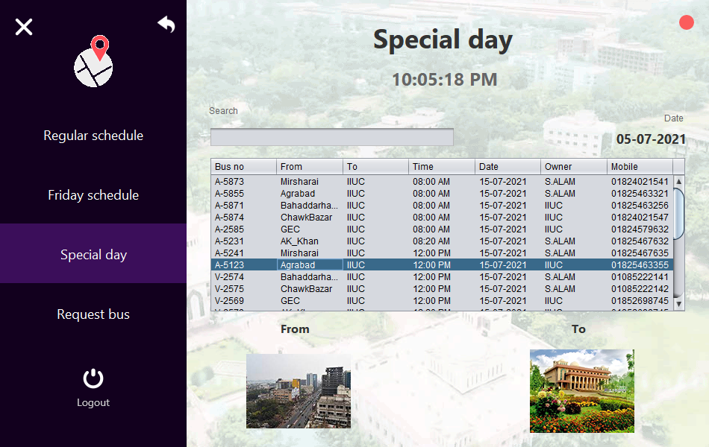
Schedule Page

Slide 10
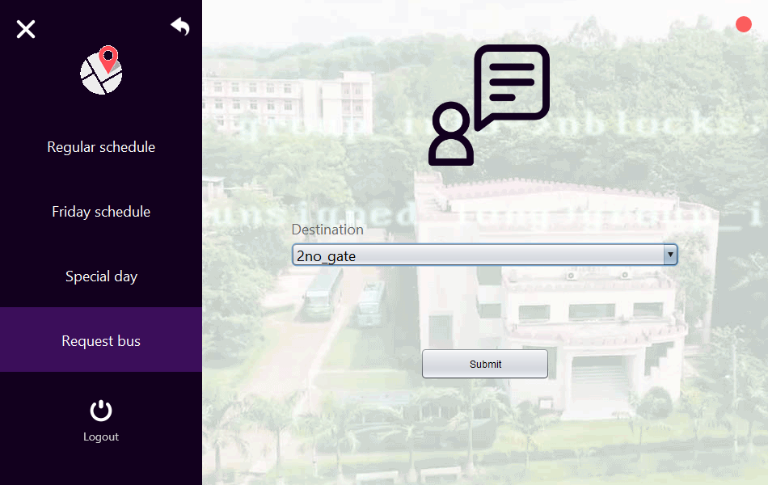
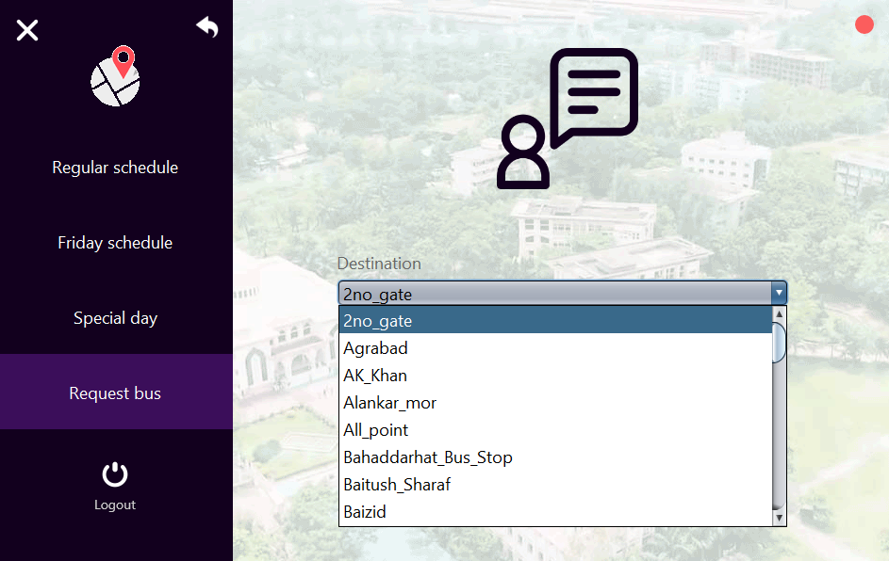
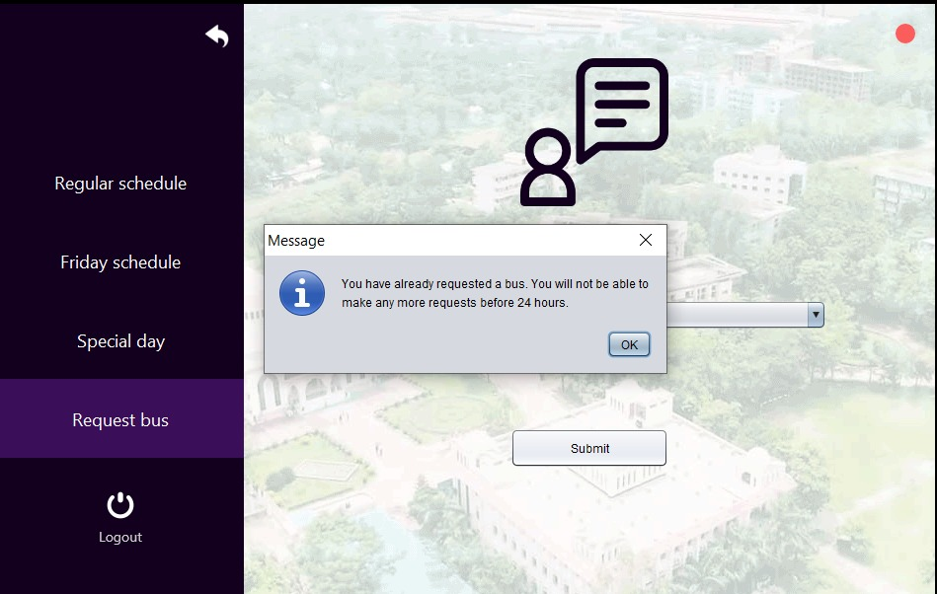
Bus Request Interface

Slide 11
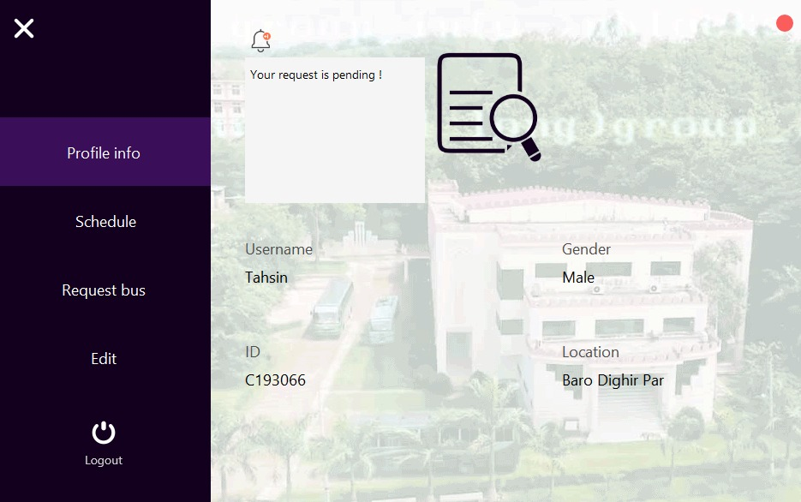
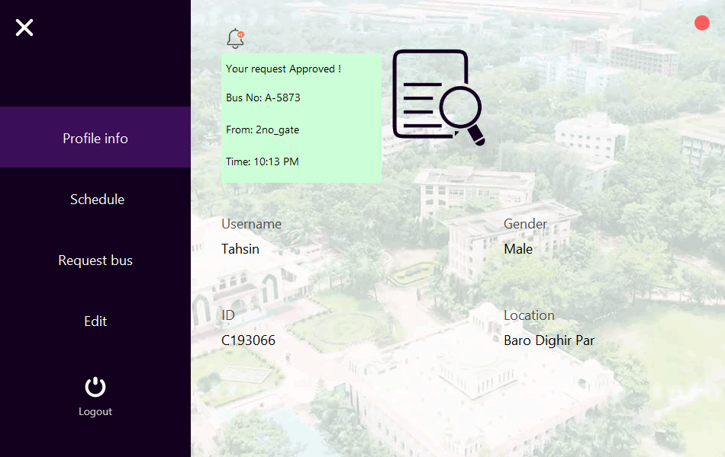
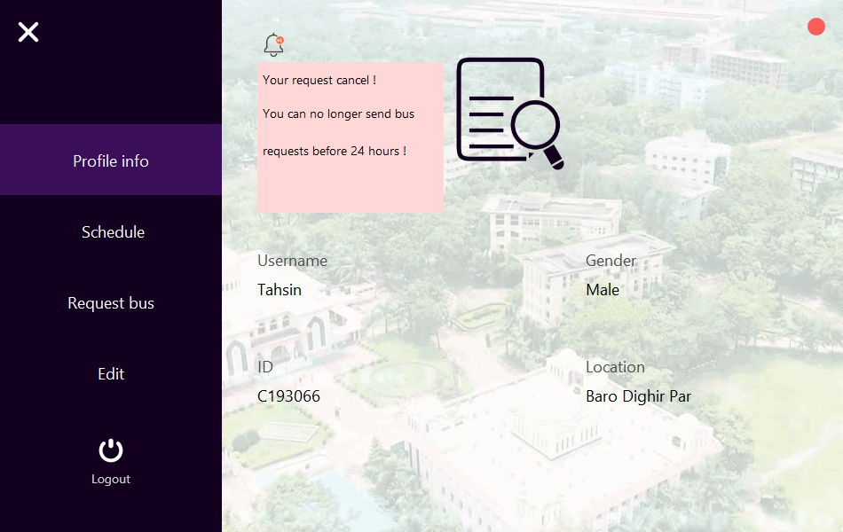
Bus Request Notification

Slide 12
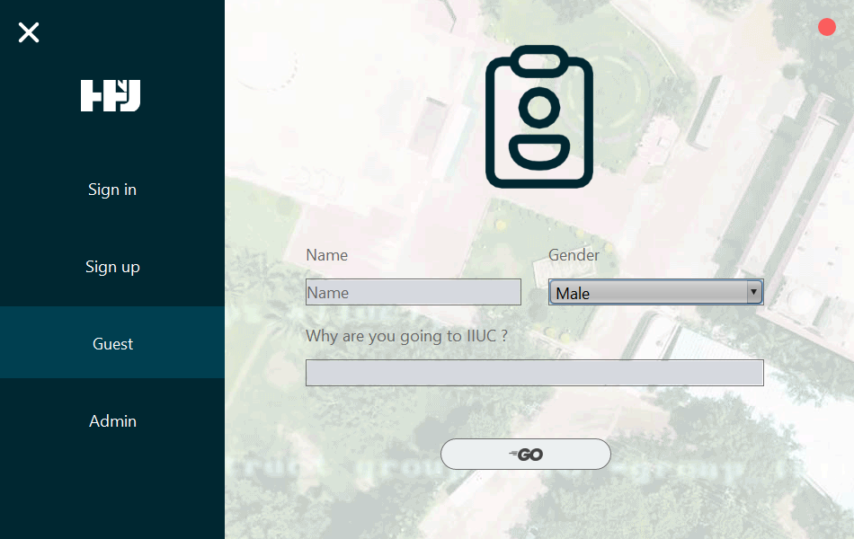
Guest Interface

Slide 13
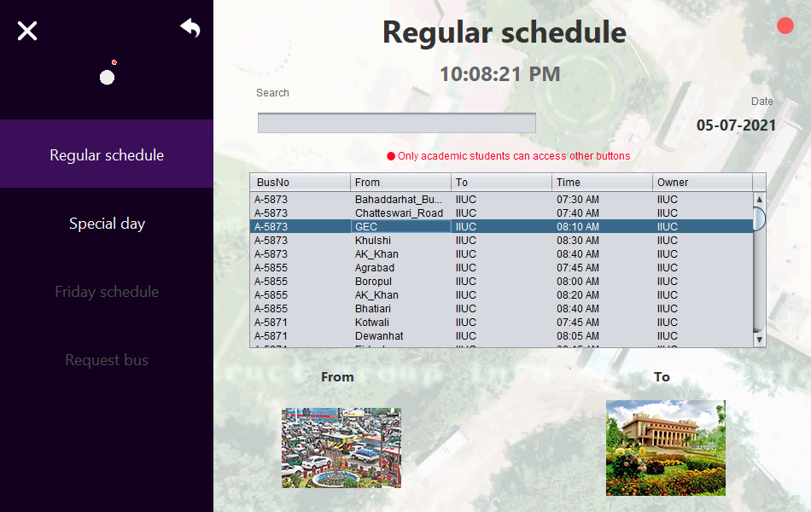
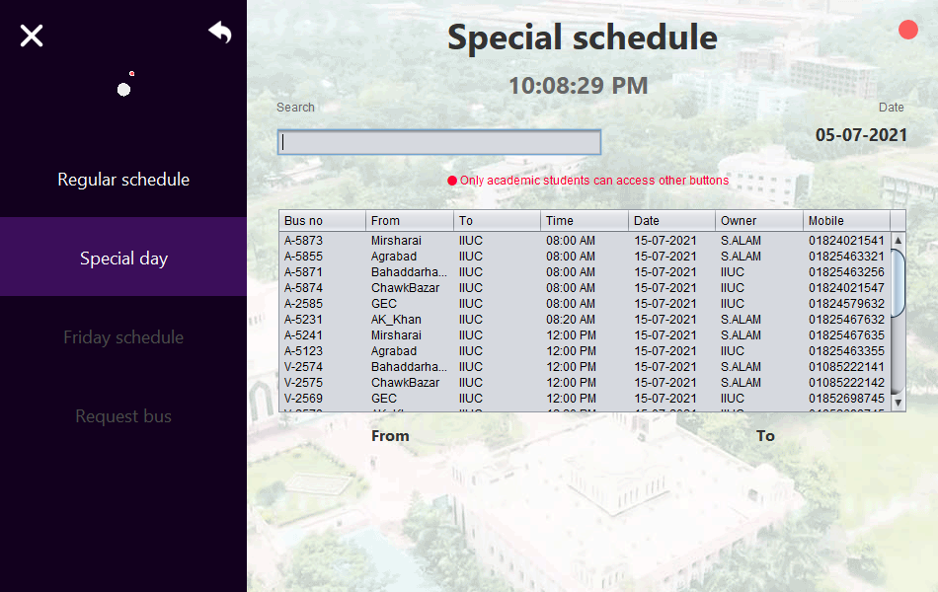
Guest Schedule

Slide 14
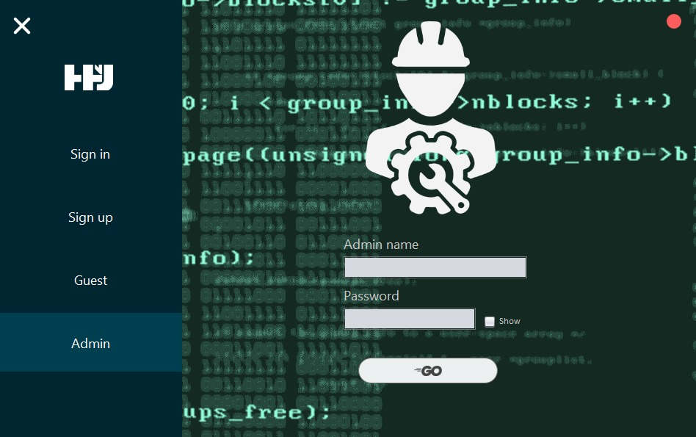
Admin Login Interface

Slide 15
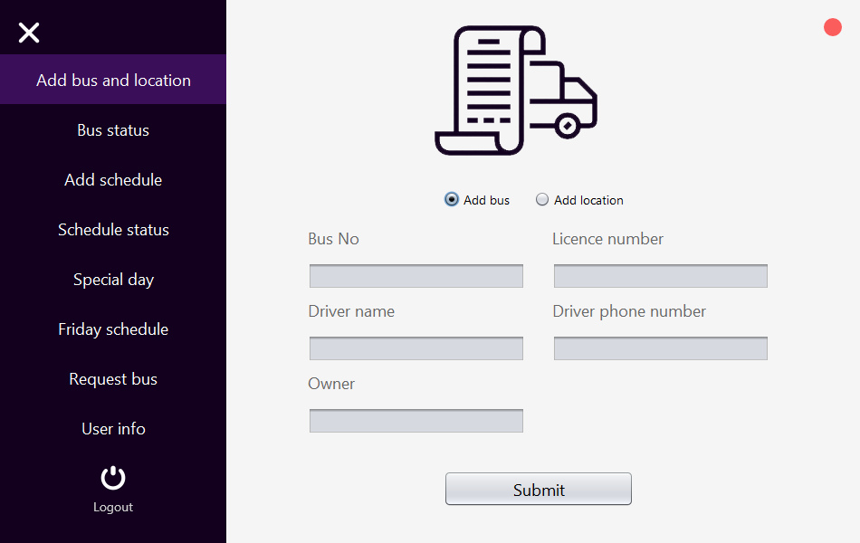
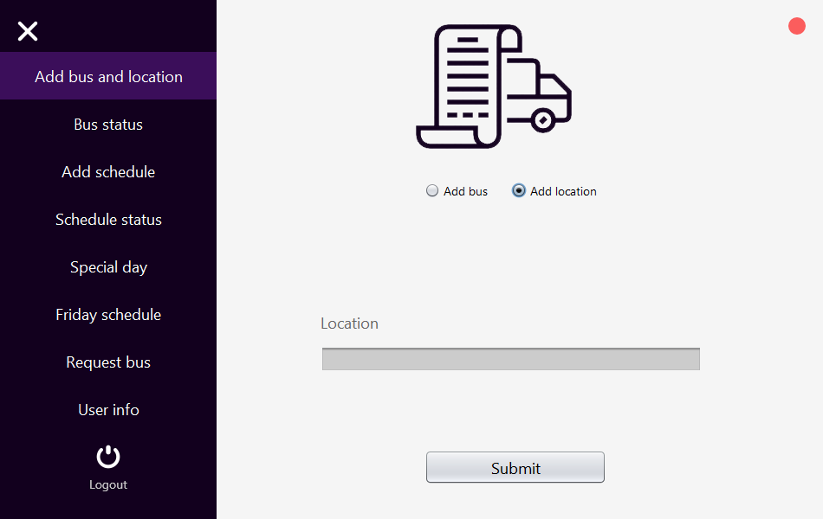
Admin System

Slide 16
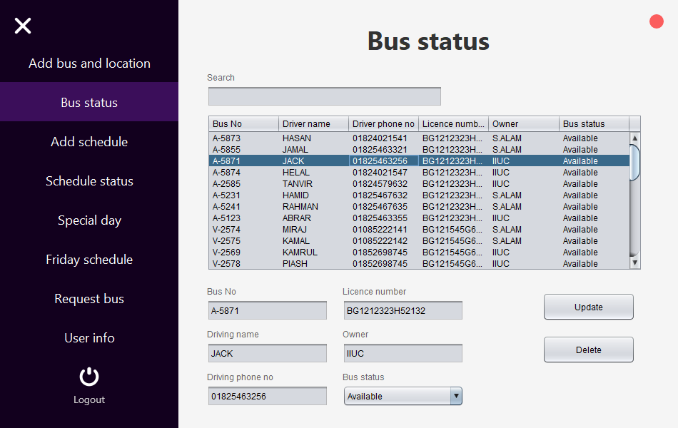
Admin System

Slide 17
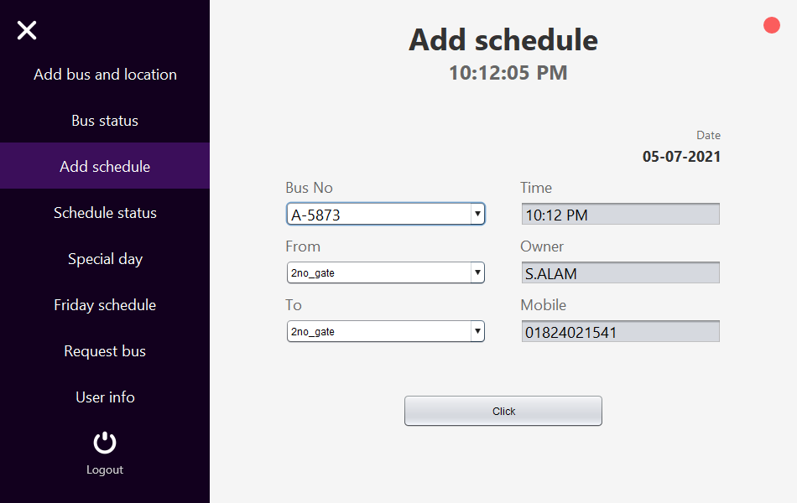
Admin System

Slide 18
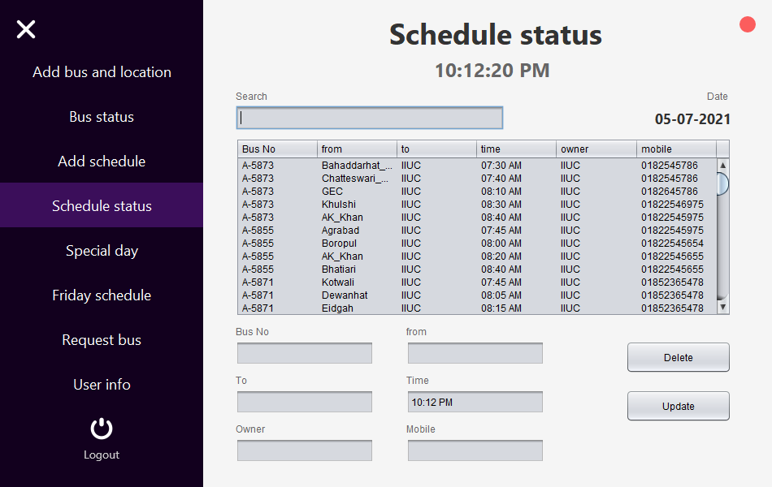
Admin System

Slide 19
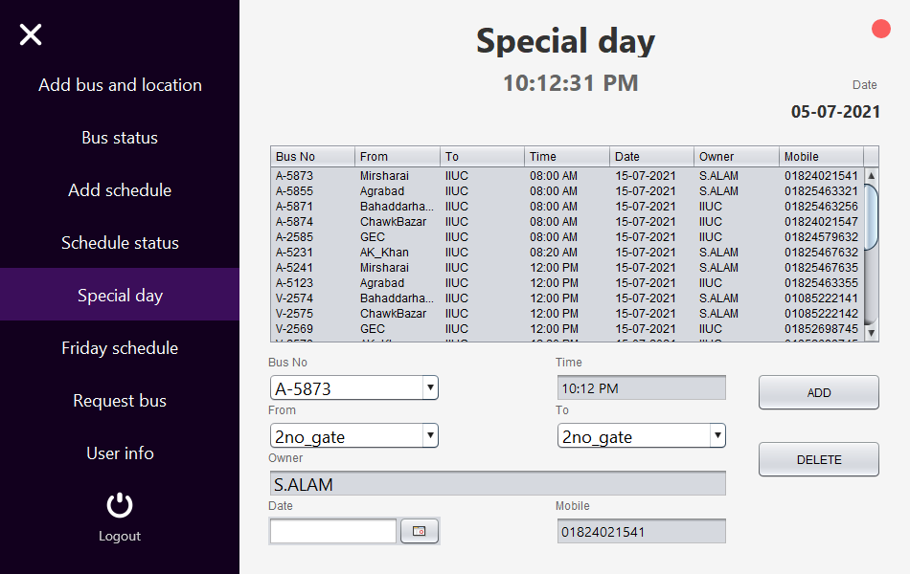
Admin System

Slide 20
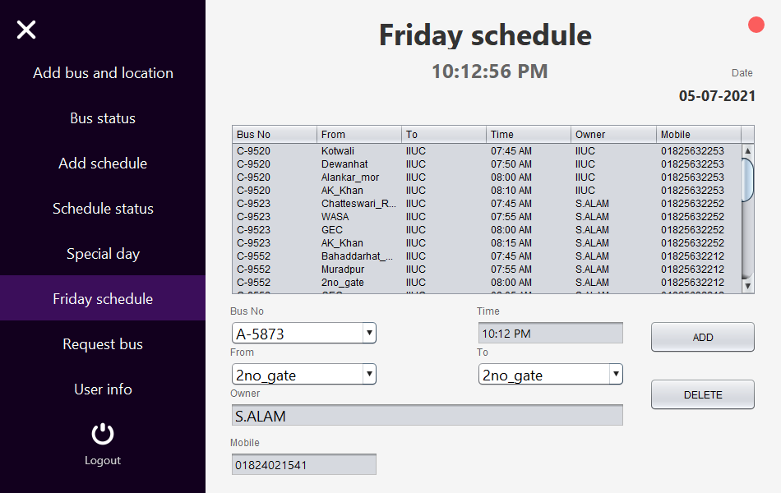
Admin System

Slide 21
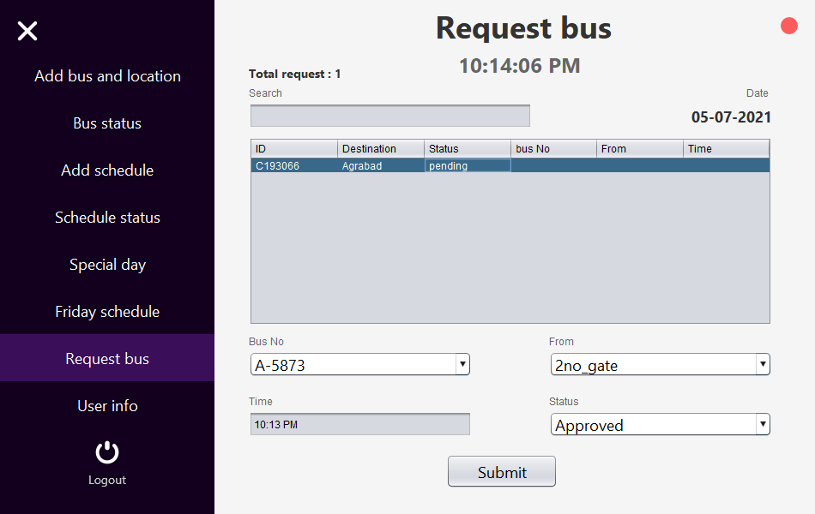
Admin System

Slide 22
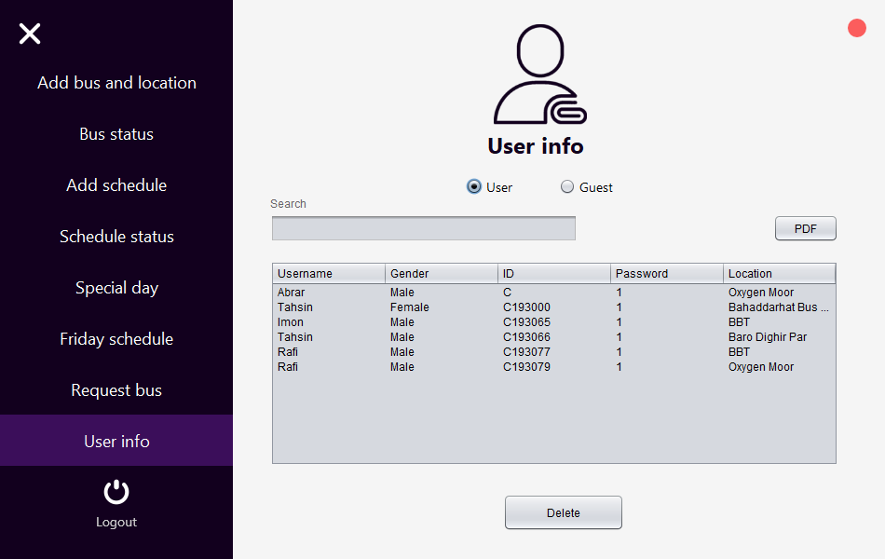
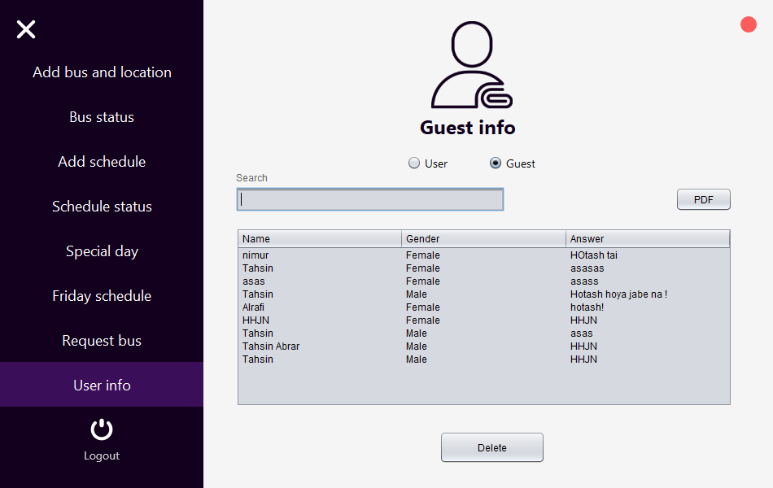
Admin System

Slide 23
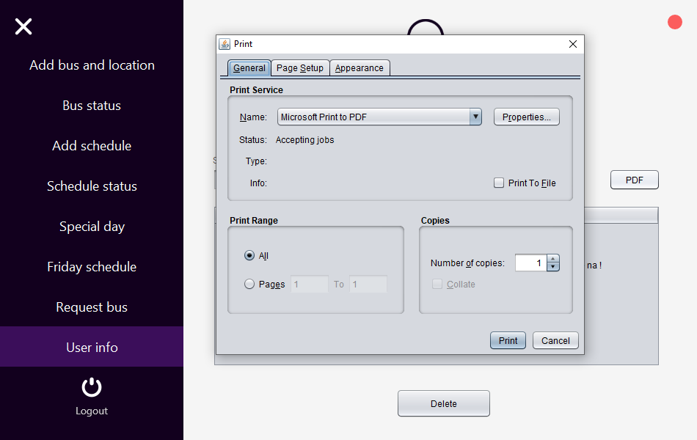
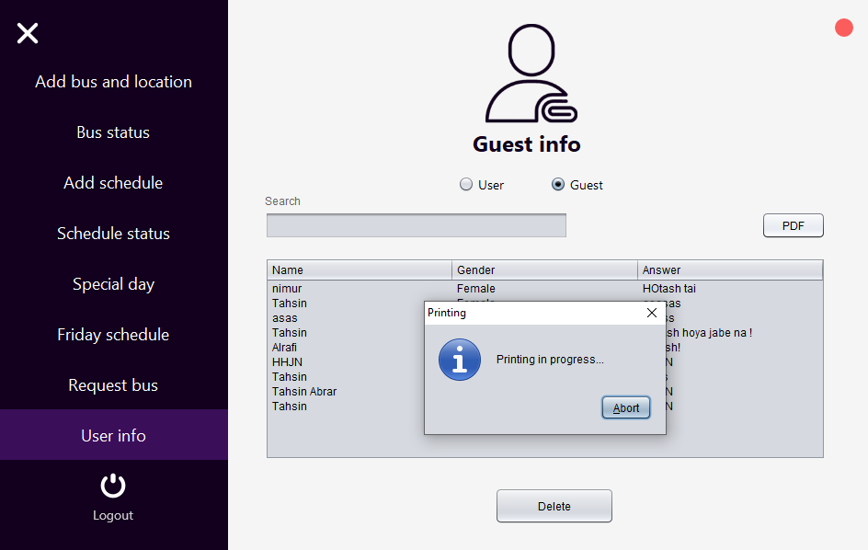
Admin System

Slide 24
Submitted By :
Team : HHJN
Developed By:
Tahsin Abrar (C193084)
Nimur Rashid Imon (C193066)
Montasir Tasnim AL Rafi (C193079)
Mohammad Rahatul Islam (C193075)
Md Rafidul Islam (C191065)
Submitted To:
Sazid Khan
Assistant Lecturer , IIUC

